Slide 1
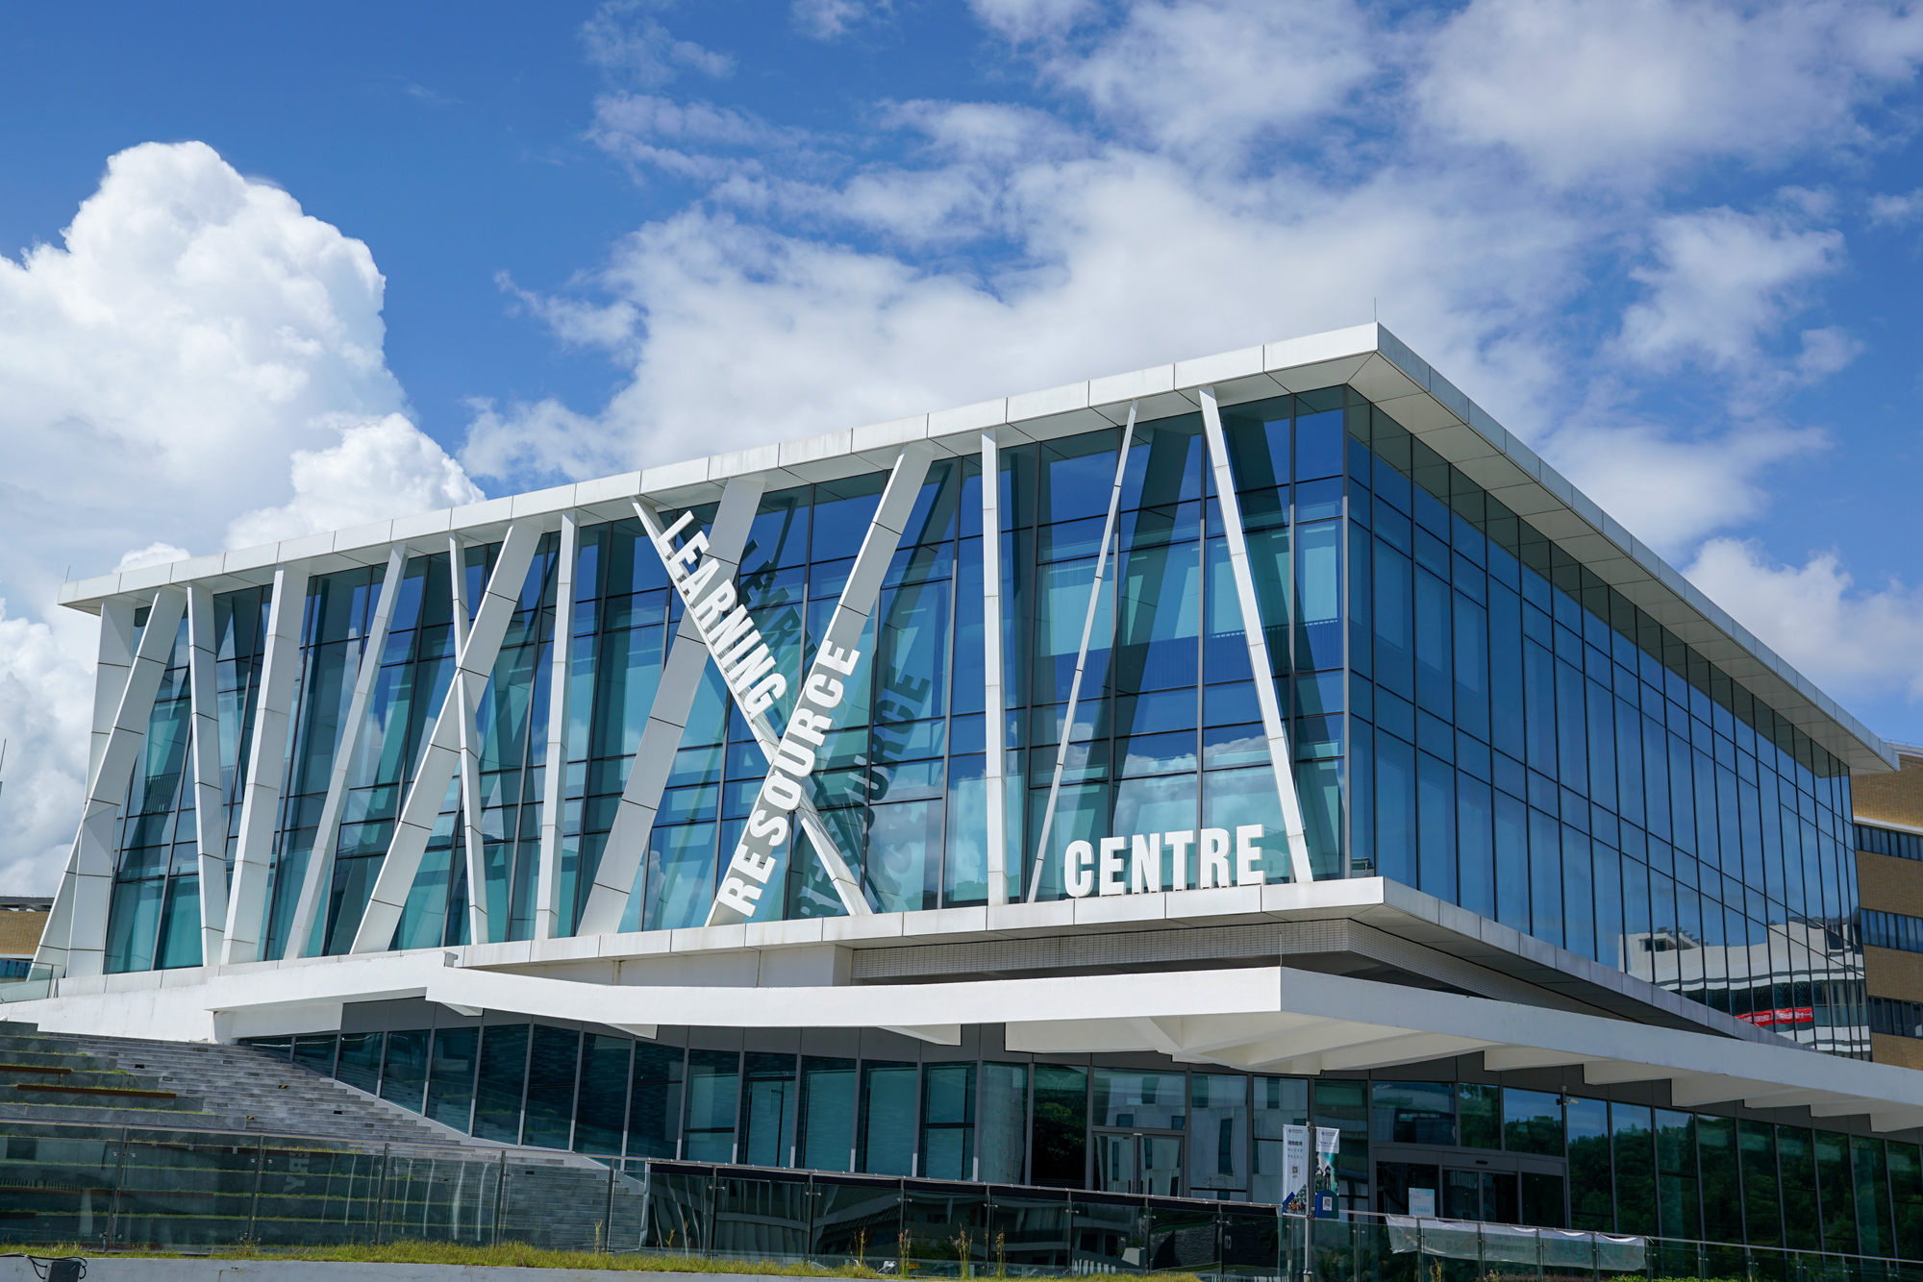
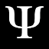
2022
Conference Manage System
Joseph 1930026109
Oliver 1930026012
Matt 1930031130
Barry 1930026064

Slide 2
Specification
CONTENS
Main features
Benefit, User Friendliness
Demonstration

Slide 3
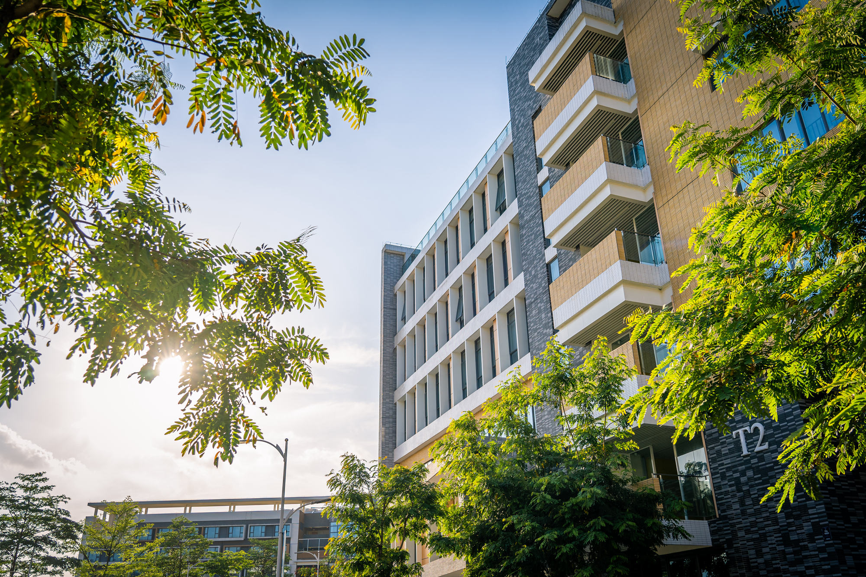

Specification Documents & Design
Matt
01
PART ONE
-- Methods & Diagrams & Models

Slide 4
Software Requirements Specification (SRS)
Detailed Design
Architecture Design
Software Testing
4 documents, 15 diagrams and many techniques applied.
Overview
- Use case diagram
- State-transitional diagram
- Class diagram
- Sequence diagram
Software Process Model:
The Waterfall Model
Design Pattern:
Model-View-Controller Model(MVC)
- Reconstrued Class diagram
- System overview
Testing plan
Testing report

Slide 5
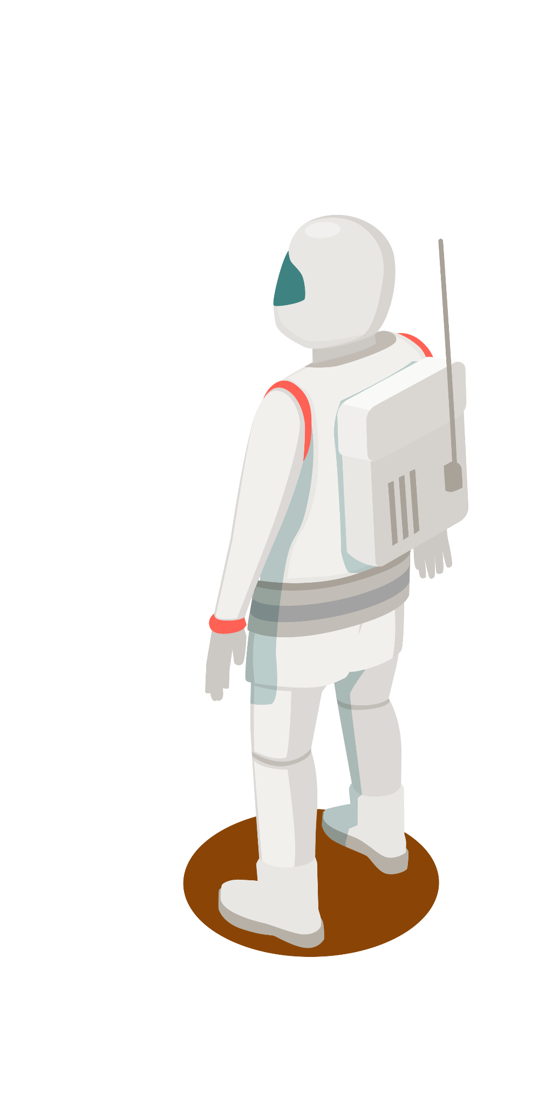
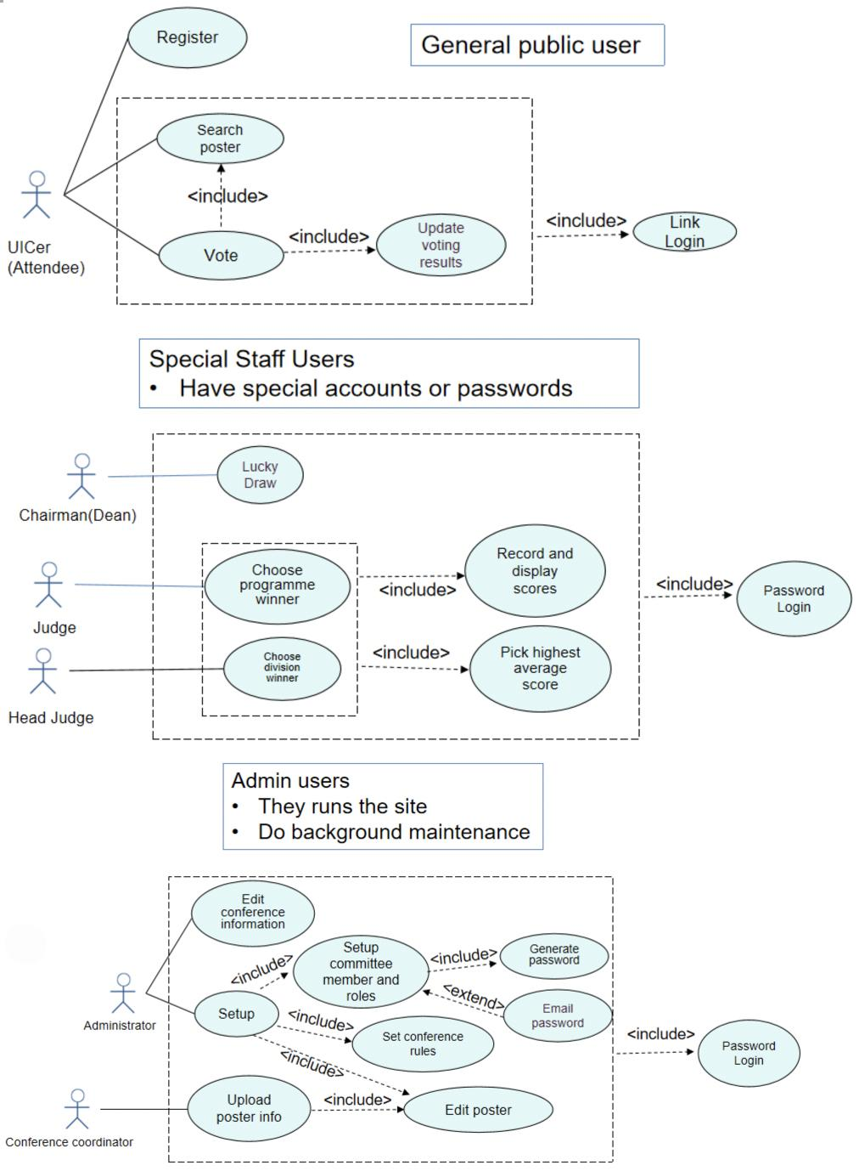
Use Case Diagram
6 Characters & 6 Use cases

Slide 6
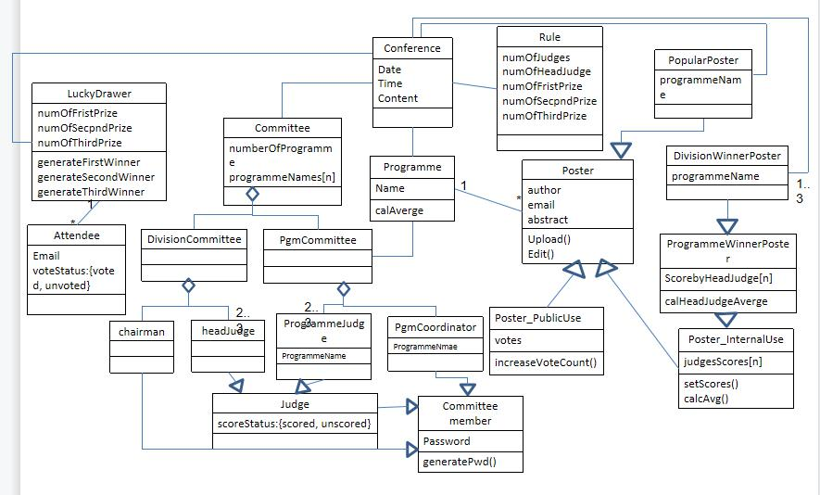
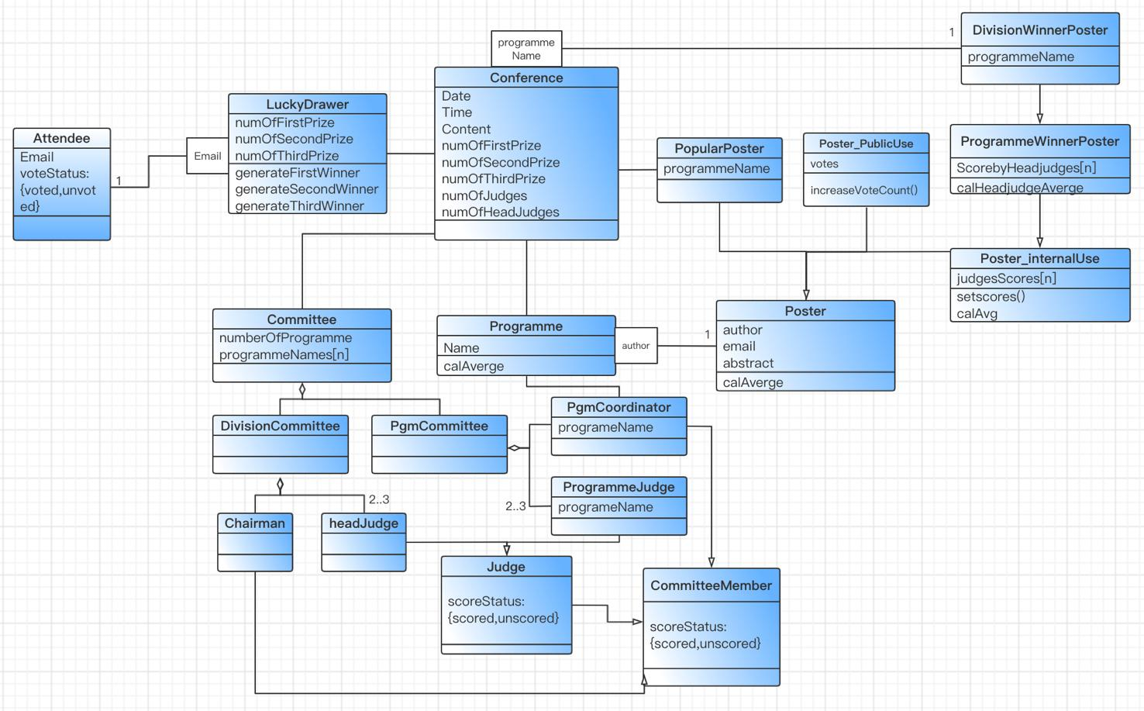
- Reconstructed Class diagram - Adding Qualifier - Increasing Inheritance
Class Diagrams
- Class diagram

Slide 7
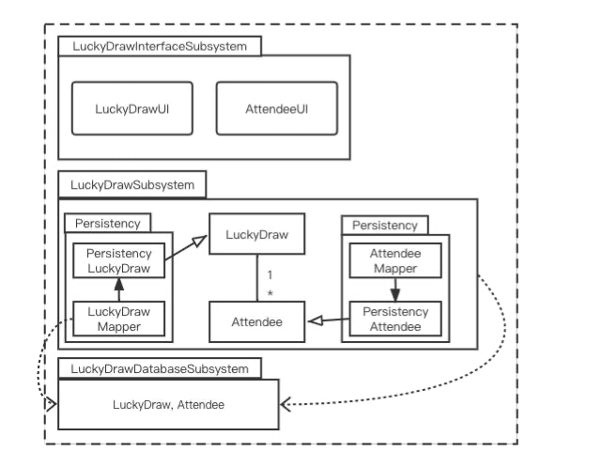
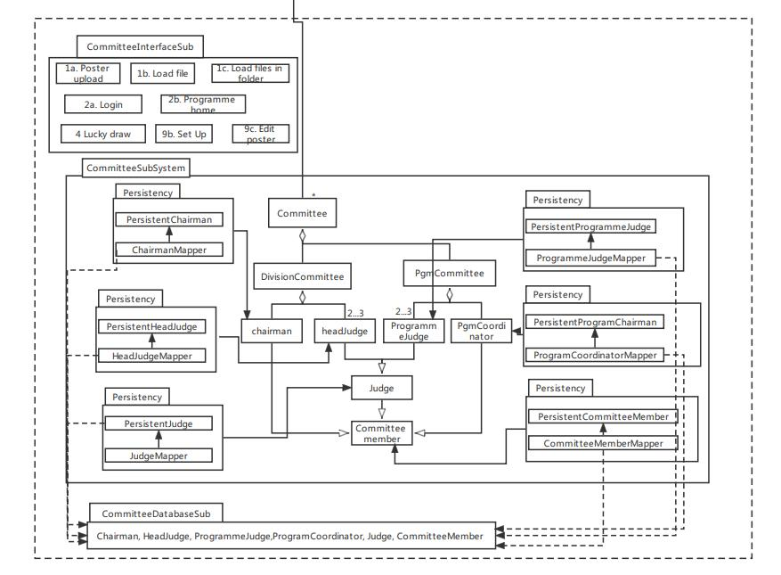
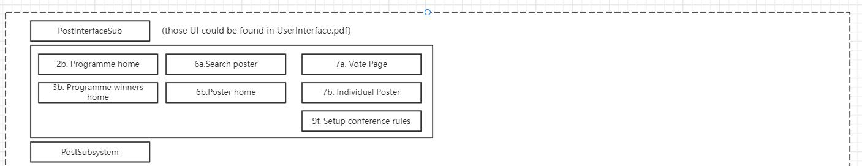
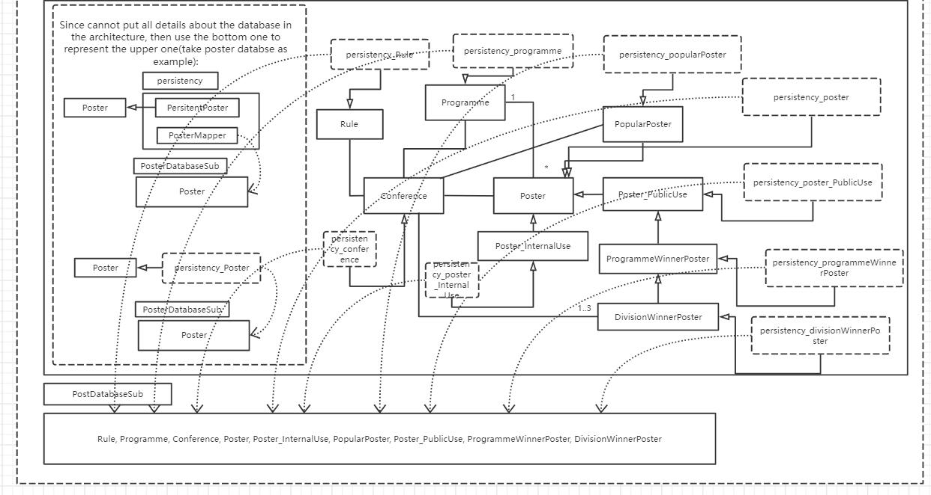
- The MVC model - Three Sub-systems
System Architecture

Slide 8
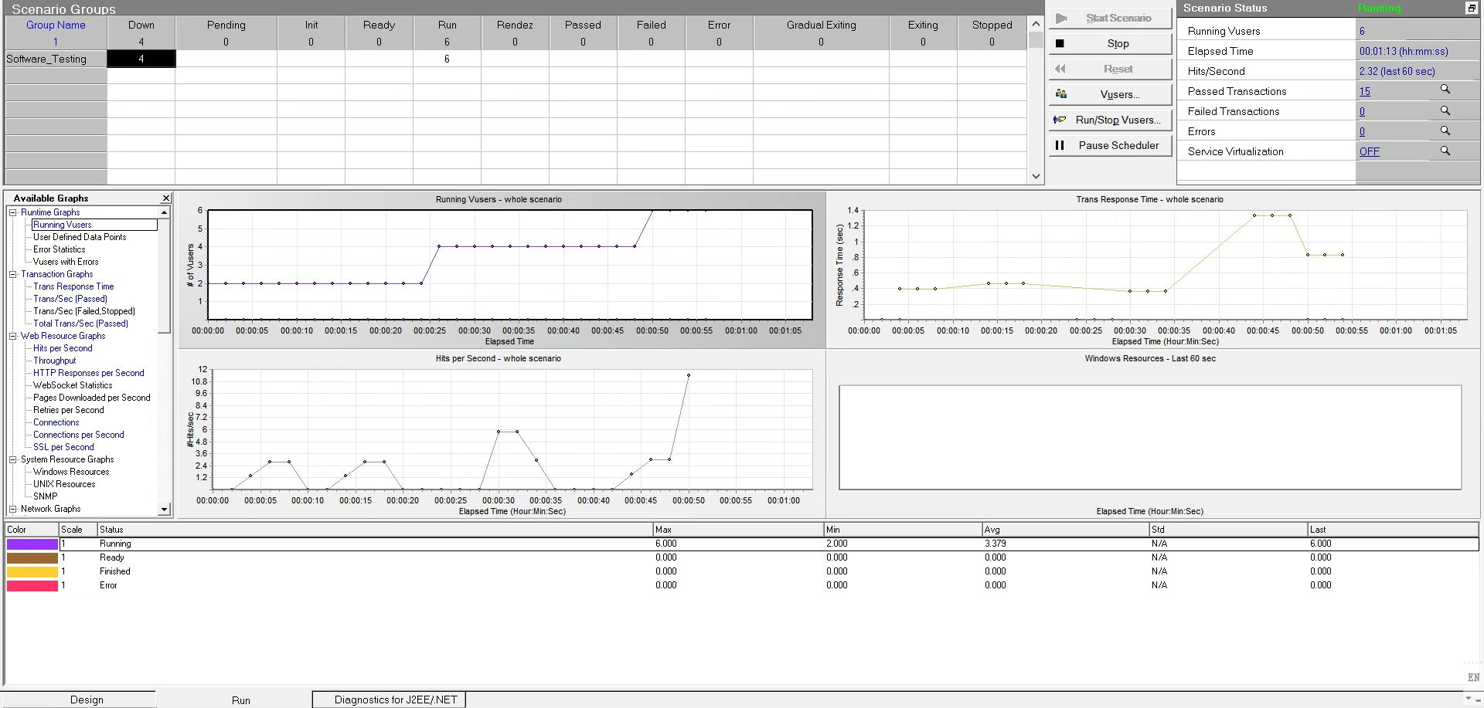
Software Testing & Design Independence
Testing Method:
Black-box testing
( Equivalence class testing)
Testing Level:
Integration Testing
Load Testing
(Load Runner)
Optimizing the Cohesion and Coupling

Slide 9
02
Main features
Oliver
PART TWO

Slide 10

What tools do we use?
Concise
Python-Flask
Why?
Comparation--Java : Python is more concise (time cost)
Comparation--Django : full-stack web framework
Flask : Light-weight framework (consider base on size)
Only two main dependencies : Werkzeug & Jinja2
Flexible : Full control of decisions to build
Coherent and neat API
Easy and flexible configurations

Slide 11
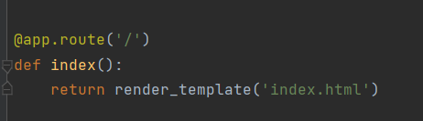
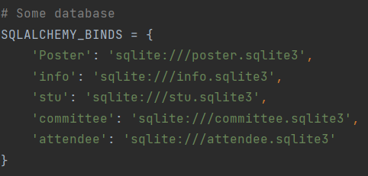
What problems do we meet?
Connection
Between HTML(templates) and controller
Route
Between model and database
Flask-sqlalchemy
Easy for maintenance
Easy to comprehend

Slide 12
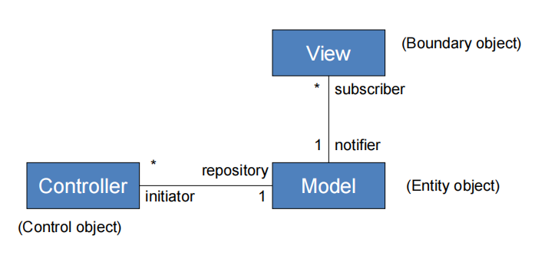
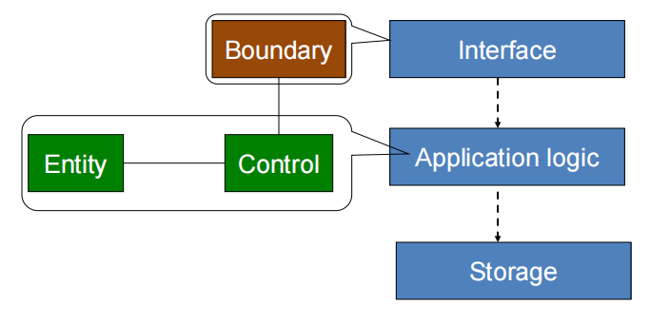
What do we changed during coding?
1. Model
MVC
The Layered Model – Three Tier

Slide 13
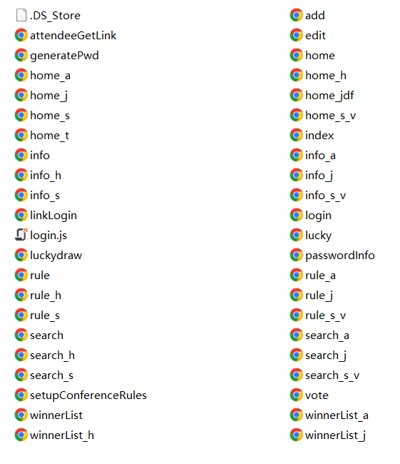
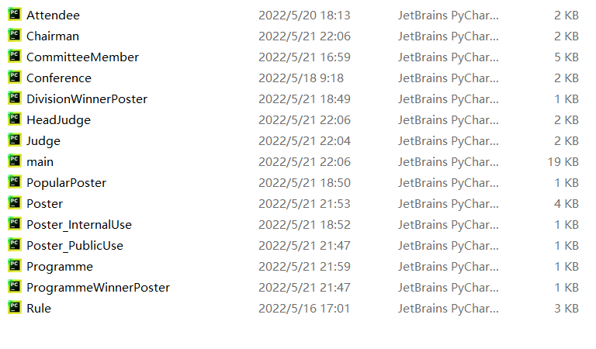
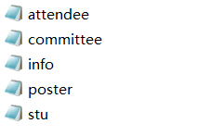
What do we changed during coding?
1. Model

Slide 14
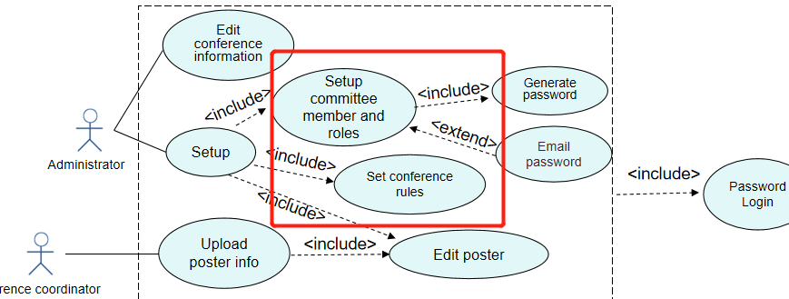
What do we changed during coding?
2. Assumption --
To make product concise & meet all requirements
Rule

Slide 15
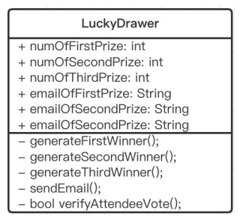
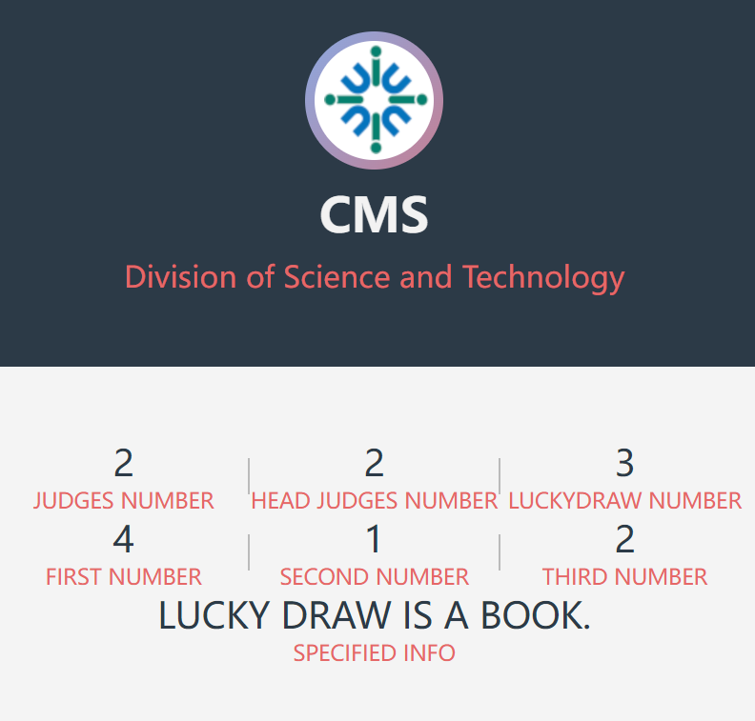
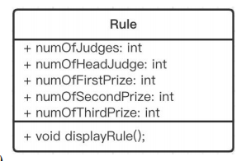
What do we changed during coding?
2. Assumption

Slide 16
What do we changed during coding?
2. Assumption
IDEA:
User Friendly
Meet the requiements

Slide 17
After solving those problems...
We done a nice work!
User Interface

Slide 18
03
Benefit and User Friendliness
Joseph
PART THREE

Slide 19
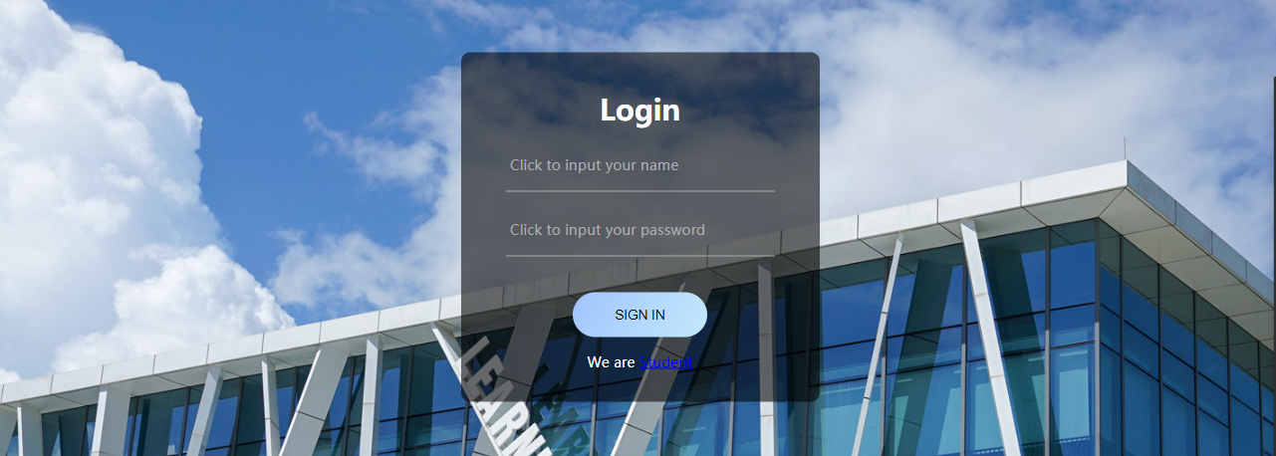
Multiple login methods
We provide different login methods for attendee and students. Committee needs to enter the password while entering the account to log in.

Slide 20
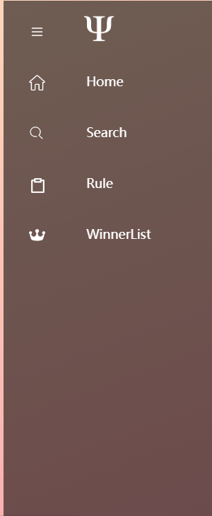
Hover
Different users see different initial interfaces.
Here, we control the permissions of different users through the hover.

Slide 21
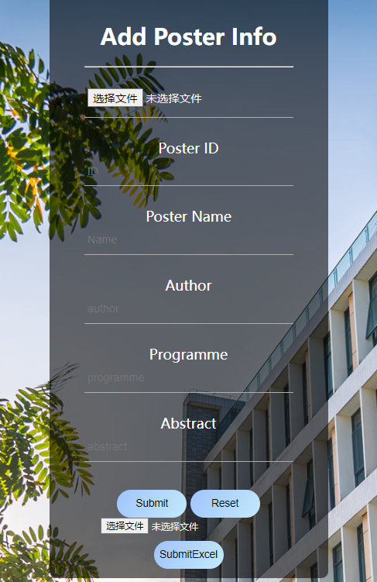
Userfriendly-Administrator
We provide a function of recording table data. The administrator can directly upload an excel table containing a large number of posters.
Click Here

Slide 22
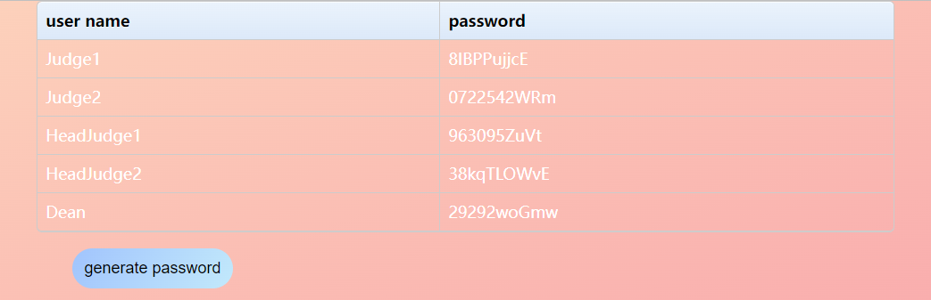
Userfriendly-Administrator
The administrator can randomly generate passwords for all advanced users with one click.

Slide 23
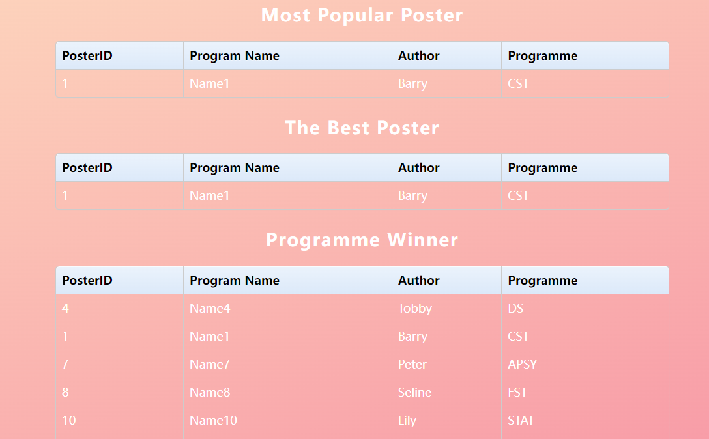
Userfriendly-Judge
For two classes with similar permissions, judge and headjudge, we let them all see all the posters.

Slide 24
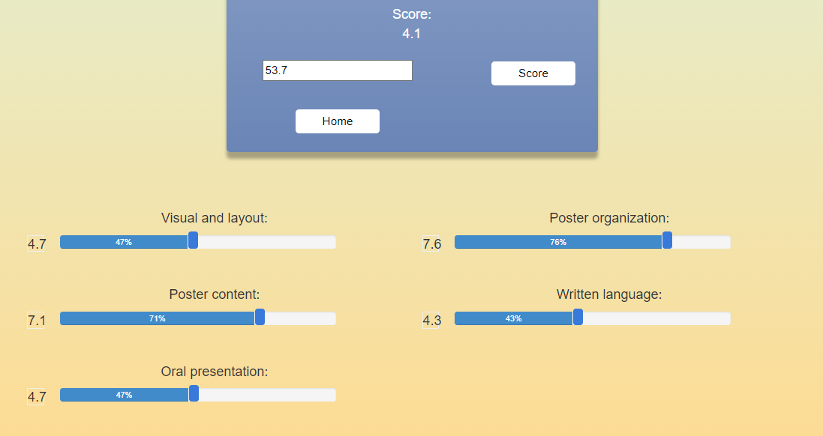
Userfriendly-Judge

Slide 25
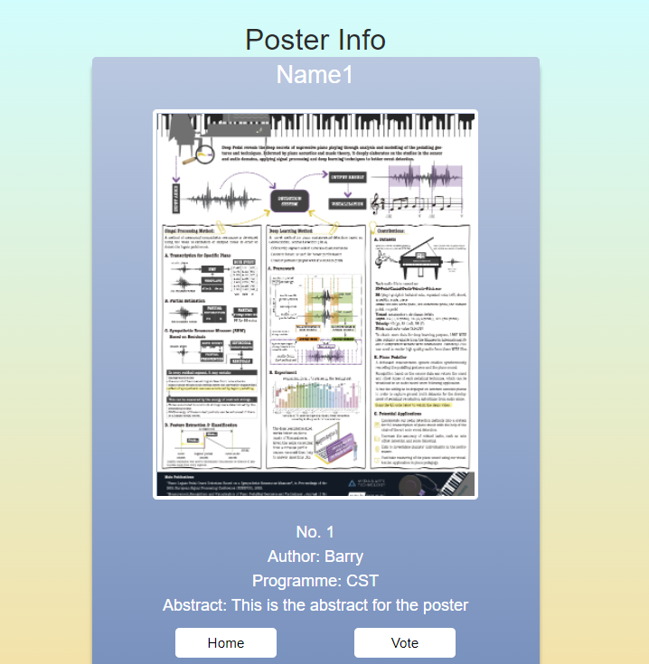
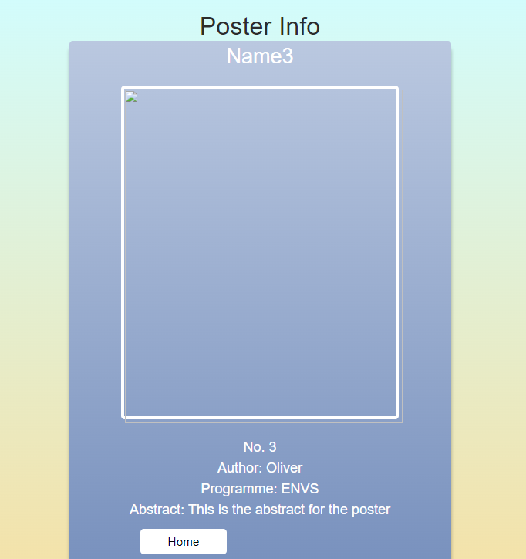
Feature-Student
When students vote, our system will detect whether the students have finished voting. If they have already voted, they can't vote for others.

Slide 26
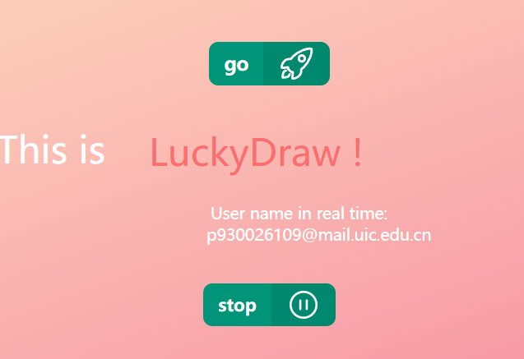
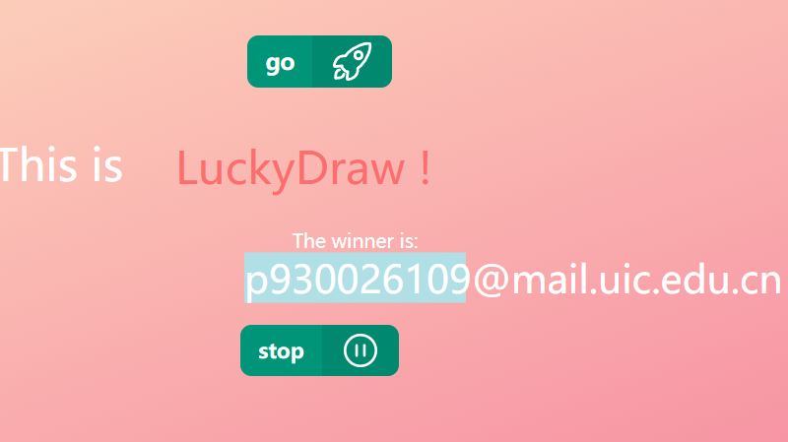
Feature-Luckdraw

Slide 27
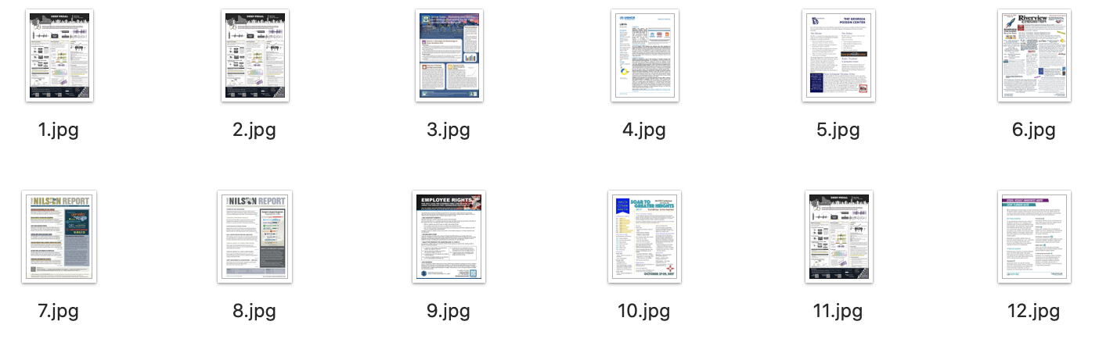
Feature-Poster
The poster photos we upload to the website will be files with various names, but the photos saved in the folder of our program after uploading will record the corresponding poster ID

Slide 28
04
Demo
Barry
PART FOUR

Slide 29
THANKS

